Slide 1
OTOD Case Report Award
Mouna Alsunni, BDS
Oral Medicine Resident, PGY2
Mouna.alsunni@tufts.edu

Slide 2
Disclosure
Neither my co-authors nor I have financial/personal conflicts.
Notes:
Nothing to disclose

Slide 3
Chief complaint
A 51-year-old caucasian female was referred by her PCP for evaluation and management of a 10-year history of “oral blisters”

Slide 4
HPI
Ten-year history of “oral blisters”
Occurring approximately once a month
After eating salty/crunchy food
2021: Oral surgeon suspected OLP
Biopsy of left buccal mucosa performed in July 2021
“hyperkeratosis with mild cellular atypia and chronic inflammation”
No diagnosis given
No treatment rendered
A recent blood-filled blister on her right buccal mucosa prompted her to seek care in our clinic
No previous management was attempted
Notes:
Lesions enlarge after popping, leaving an ulcerated area.
Lesions are occasionally symptomatic when she intentionally pops the blister.
Lesions are provoked only by crunchy food.

Slide 5
History
Medical History | Hemochromatosis, basal cell carcinoma, dermatitis
Review of systems | No history of rash or bleeding disorders
Allergies | Seasonal
Adverse drug reactions | Codeine (vomiting)
Medications | Fluticasone spray PRN – do not report pain medications or blood thinners
Occupation | Compliance officer
Smoking | Denies
Alcohol | 1-3 glasses per month
Family history | Mother: skin cancer; Father: cardiac bypass surgery – no bleeding disorders
Notes:
Explain hemochromoatosis
No-pain medications/blood thinners (or bleading disorders in family)

Slide 6
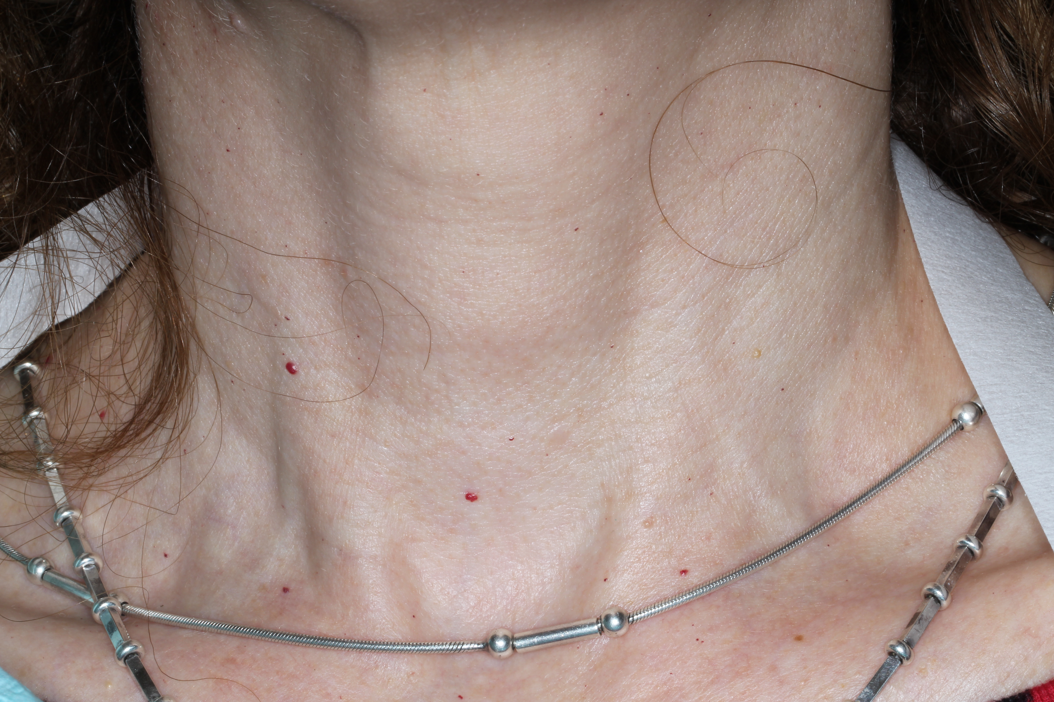
Extra-oral Examination
Notes:
Multiple 1.5-2 mm round cherry angiomas noted in the skin of neck and back

Slide 7
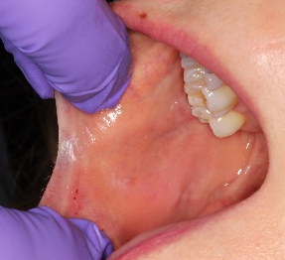
Intra-oral Examination
First visit
Notes:
No evidence of blisters
Patient was avoiding crunchy food
Bilateral symmetrical scattered linear white plaques extending along the occlusal plane with slight erythema on the left buccal mucosa

Slide 8
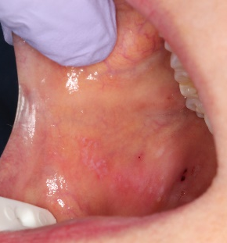
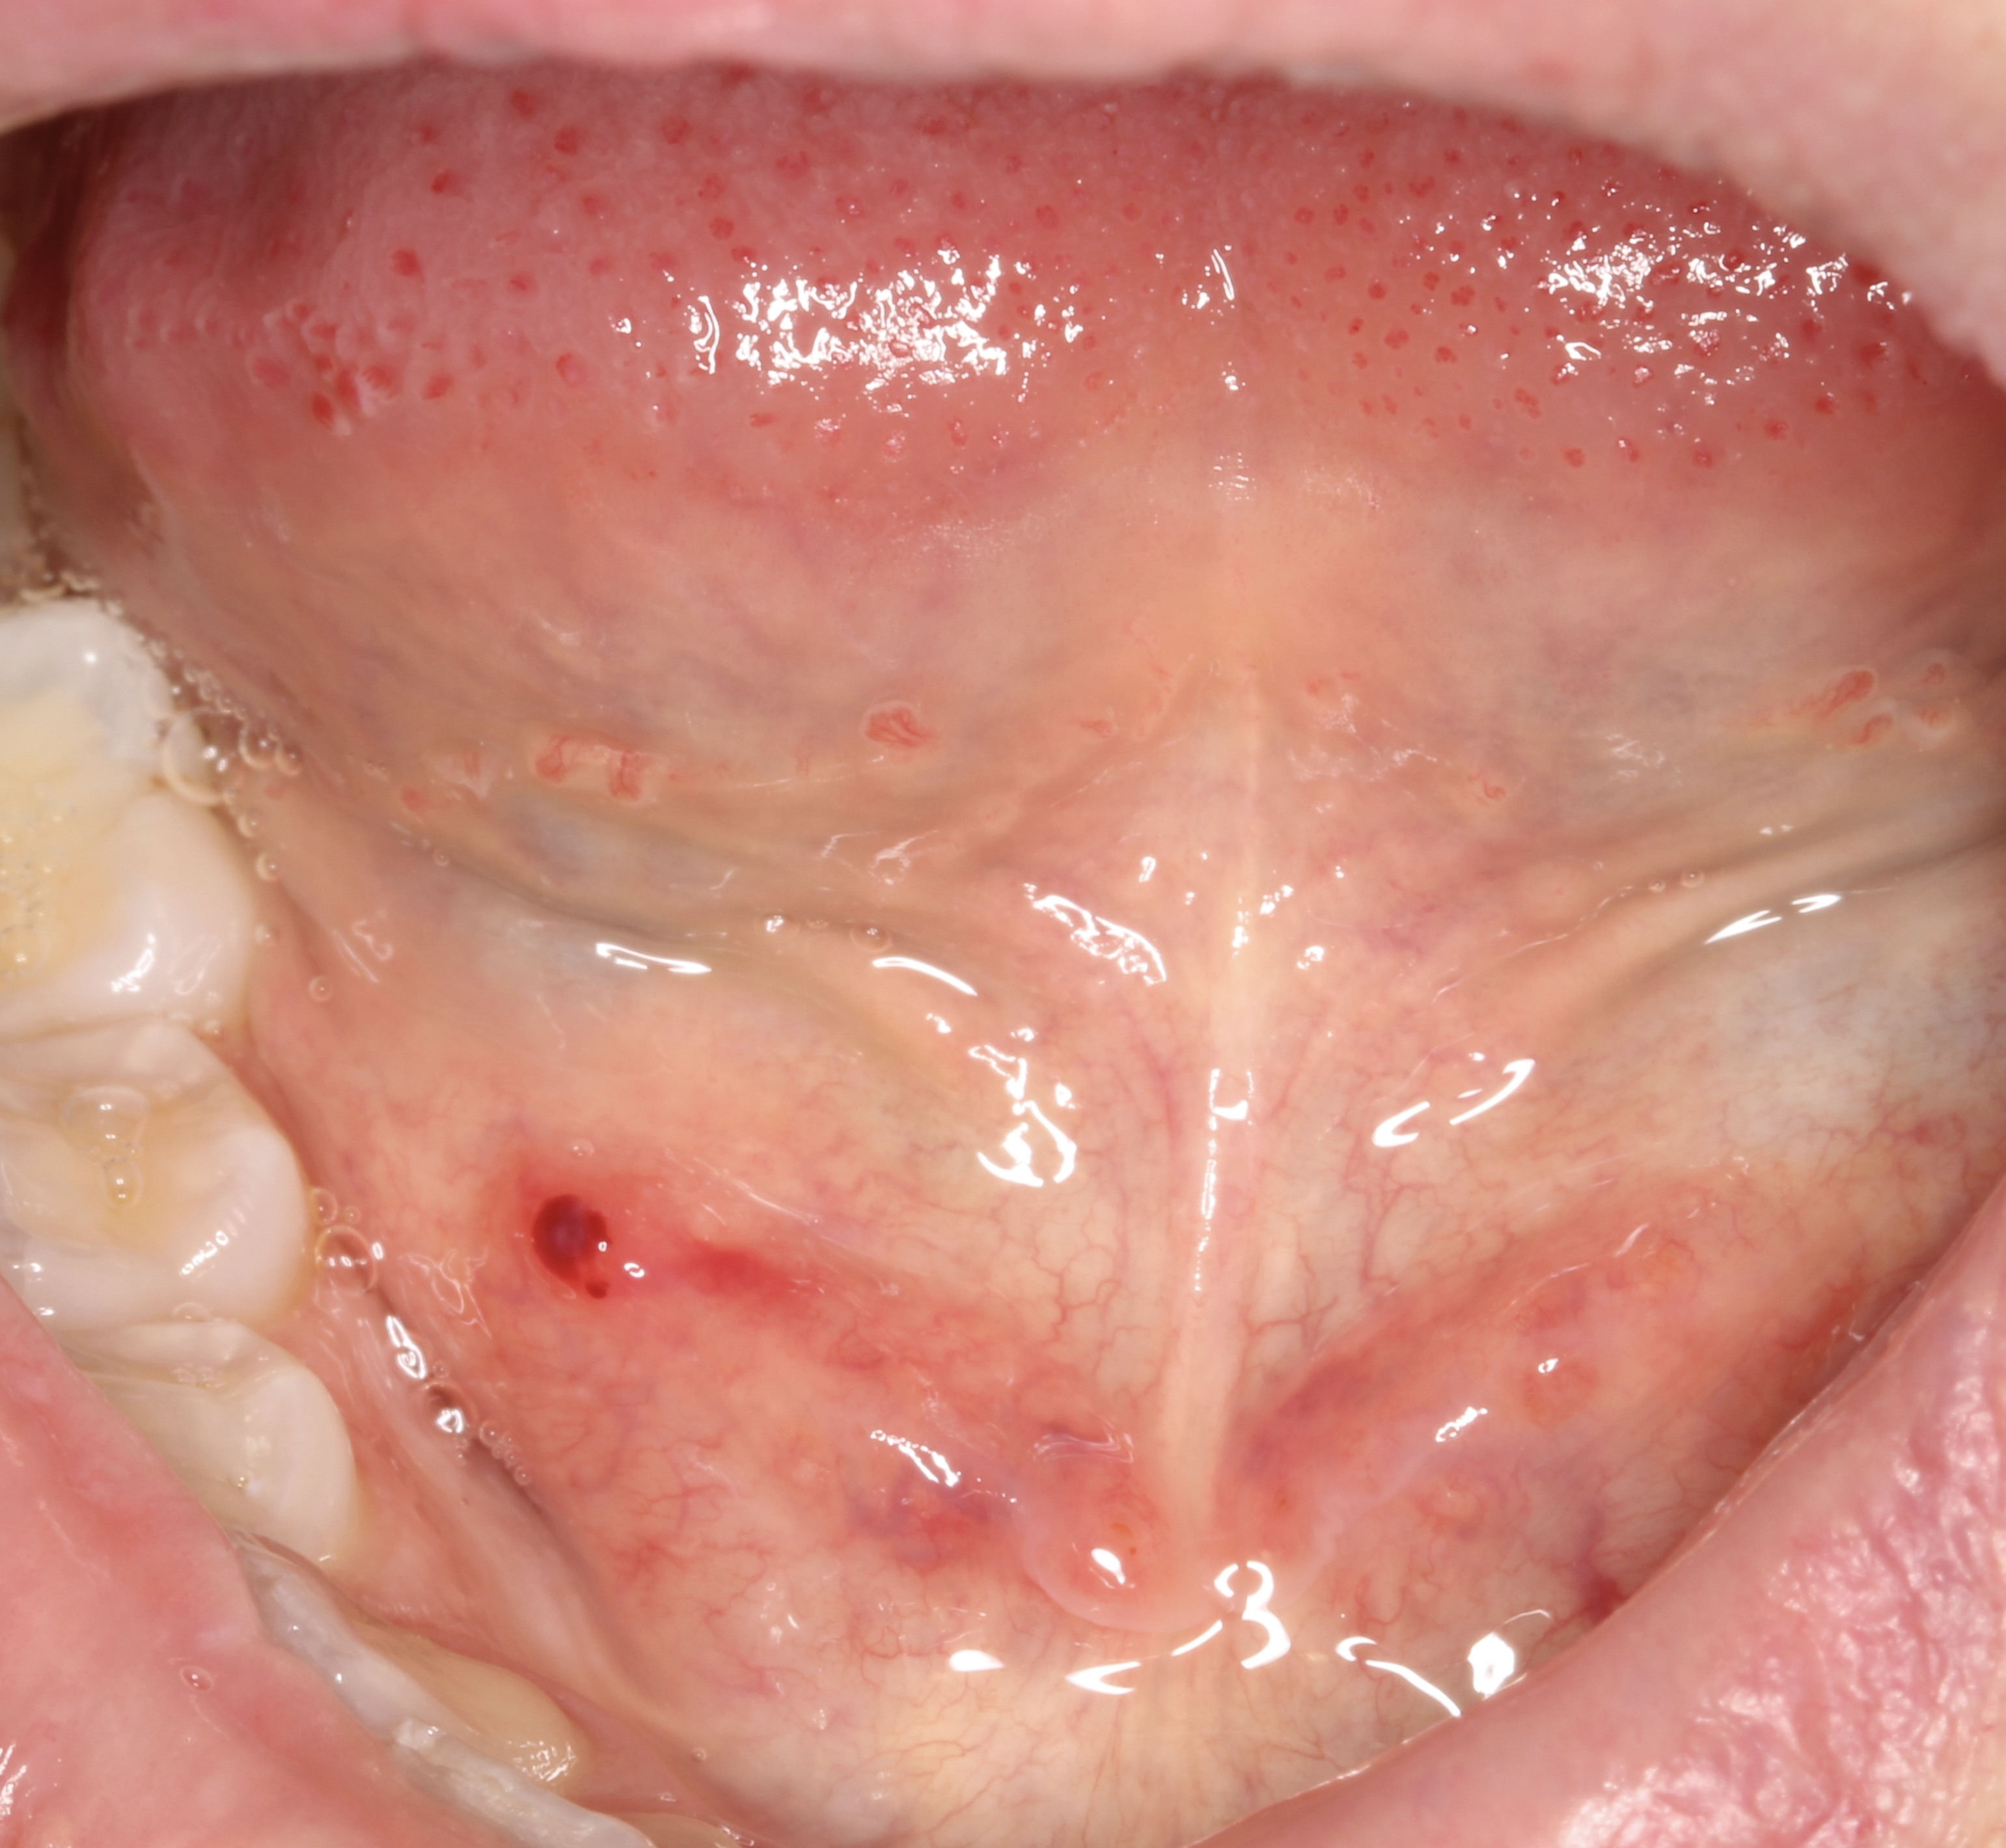
Intra-oral Examination
4-month follow up
Notes:
The patient returned for a follow-up after she had crunchy food the night before
Linear white plaques are more evident bilaterally
New: multiple 1.0-1.105 mm round blood-filled vesicle in the posterior right buccal mucosa opposite to the molars, left buccal mucosa next to the labial commissure, and right floor of the mouth

Slide 9
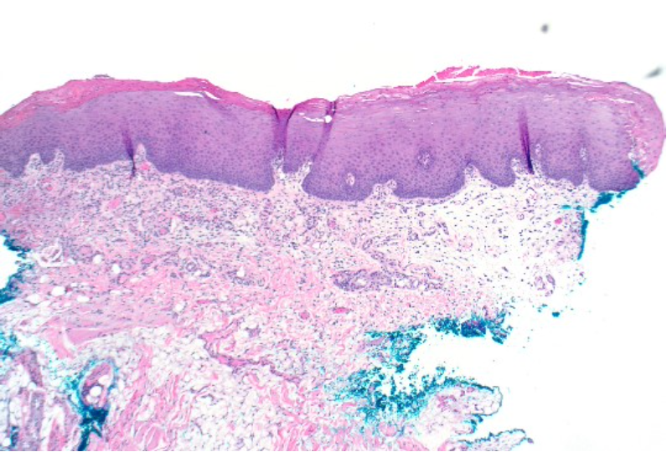
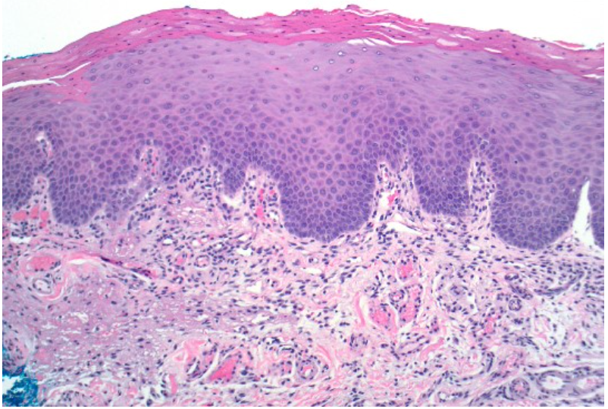
Differential Diagnosis
x40
Mucosal conditions:
Pemphigus vulgaris
Mucous membrane pemphigoid
Oral lichen planus
Bleeding disorders
Angina bullosa hemorrhagica
Test | Reference | Value
Lymphocytes | 1.00-5.00K/uL | 1.27
RBC | 4.00-5.20 m/uL | 4.72
WBC | 4.00-11.00K/uL | 6.16
Platelet count | 150-450 K/uL | 191
VWF | $≥$ 40% | 95
ALT | 0-55 IU/L | 30
AST | 15-37 IU/L | 30
DIF: Negative
x100
Notes:
A. Multiple sections show parakeratinized stratified squamous epithelium of normal thickness overlying fibrovascular tissue with scattered chronic inflammatory cells. Striated muscle bundles and regional adipose tissue also are seen.
B. Sections were incubated with fluorescein-labeled antibodies to C3, IgG, IgG4, IgA, IgM and fibrin / fibrinogen.
Signed out as oral mucosa with mild chronic inflammation
Mucosa disorders

Slide 10
Final Diagnosis
Angina bullosa hemorrhagica (ABH)
Notes:
After excluding bleeding disorders and vesiculobullous diseases, we reached a diagnosis of ABH

Slide 11
Management
Informed about the nature of the condition
Instructed to avoid provoking factors
Instructed to avoid popping the vesicles

Slide 12
Literature Review

Slide 13
Background
Balina (1933): Traumatic oral hemophlyctenosis
Badham (1967): Angina bullosa hemorrhagica
Scully (1992): localized oral purpura
Deblauwe (1994): Stomatopompholyx haemorrhagica
Blood-filled vesicles or bullae not attributed to blood dyscrasias, vesiculobullous disorders, or systemic disease
Badham NJ. J Laryngol Otol (1967)

Slide 14
Etiology
The origin and etiology of ABH are unknown.
Reported risk factors: hypertension, old age, steroid inhalers, trauma
Most accepted hypothesis:
Mild trauma, mostly during food digestion
Maciel da Rosa A et al, RSBO. 2012; Peters J et al. J Adv Oral Res. 2020 ;Ordioni et al. (2019)

Slide 15
Clinical Presentation
Painless, recurrent sub-epithelial mucosal blood-filled blisters primarily affect the soft palate.
Other sites include the buccal mucosa, floor of the mouth, tongue, anterior pillar of the fauces, epiglottis, pharyngeal wall, and esophagus.
Color ranges from dark red to purple.
Lesions heal spontaneously without leaving a scar
Grinspan D et al, Int J Dermatol. 1999; Maciel da Rosa A et al, RSBO. 2012

Slide 16
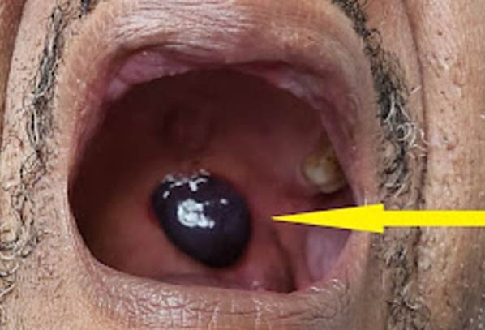
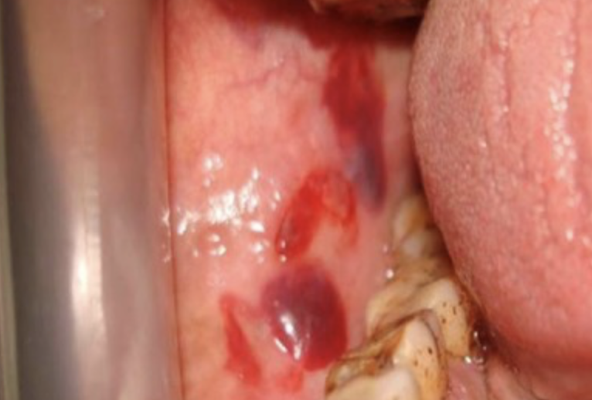
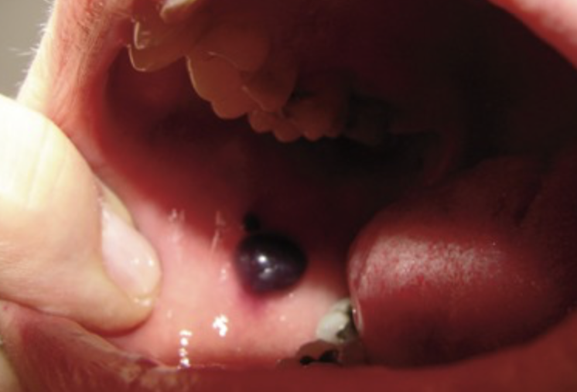
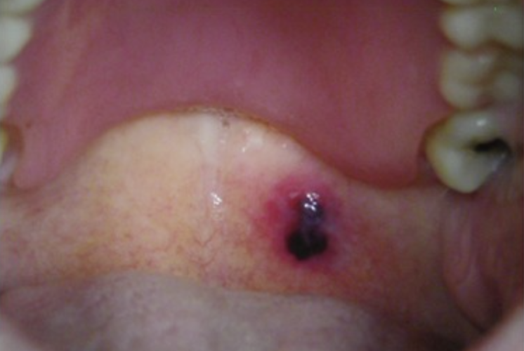
Okelue et al, 2022
Singh et al, 2022
Beguerie JR et al, 2014
Beguerie JR et al, 2014
Notes:
This is a collection of reported cases in the literature with different sites of presentation and different sizes of hematomas
Only the colored images

Slide 17
Histopathology
H&E:
Normal epithelium with chronic inflammatory cells in the lamina propria
Acanthosis
Sub-epithelial split (in biopsied bullae)
Immunofluorescent studies: negative
Normal platelet count
Stephenson P et al, 1987
Notes:
Biopsies are nonspecific. However, a study biopsied 14 cases with the following findings

Slide 18
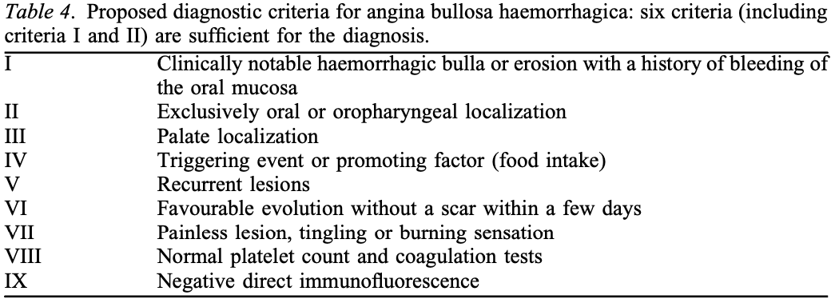
Diagnostic Criteria
Ordioni et al. (2019)
Notes:
Diagnostic criteria was implemnted by Oridione et al in 2019

Slide 19
Management
Symptomatic and reassurance
Topical analgesics and local care chlorhexidine 0.12–0.2%.
A combination of ascorbic acid and citroflavonoids is suggested to prevent recurrences of ABH
Large bullae should be excised/ drained to prevent extension and obstruction of the upper airway.
Grinspan D et al, Int J Dermatol. 1999; Stephenson P et al, 1987; C. Pahl et al, 2004
Notes:
CHX is able to (a) reduce cell proliferation and increase the expression of proapoptotic molecules, (b) increase fibrotic marker expression and myofibroblast differentiation, (c) reduce expression of RAC1 gene, characterizing keratinocyte migration and proliferation, and the ability of the oral wound to respond to stress, and (d) trigger expression of SERPINE1 and TIMP1, which regulate scar wound healing.
ascorbic acid (AA), is involved in all phases of wound healing. In the inflammatory phase it is required for neutrophil apoptosis and clearance. During the proliferative phase, AA contributes towards synthesis, maturation, secretion and degradation of collagen
Citrus flavonoids are well-known for their antioxidant and anti-inflammatory properties.

Slide 20
Reported Cases (N=225)

Slide 21
Take home message
225 reported cases
Acute, occasionally painful, benign submucosal blood-filled vesicles and bulla
Pathogenesis unclear, trauma major provoking factor
Commonly in the palatal mucosa
Diagnosis made by clinical appearance and history and exclusion of bleeding disorders, pemphigoid, oral lichen planus, and pemphigus.
Accurate diagnosis is important to avoid unnecessary treatments.

Slide 22
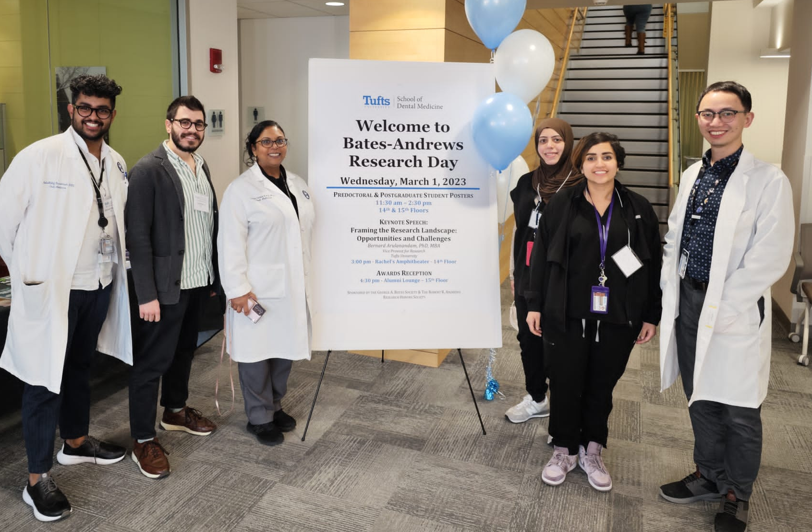
Special Thanks
Dr. Vidya Sankar
Dr. Sarah Alyousef
Department of Diagnostic Sciences
@TUSDM

Slide 23
References
Badham NJ. Blood blisters and the oesophageal cast. J Laryngol Otol. 1967 Jul;81(7):791-803. doi: 10.1017/s0022215100067700. PMID: 6029172.
Beguerie JR, Gonzalez S: Angina bullosa hemorrhagica: report of 11 cases . Dermatol Reports. 2014, 6:5282. 10.4081/dr.2014.5282
Deblauwe BM, Van Der Waal I (1994). Blood blisters of the oral mucosa (angina bullosa haemorrhagica). J Am Acad Dermatol 31: 341– 344.
Grinspan D, Abulafia J, Lanfranchi H: Angina bullosa hemorrhagica. Int J Dermatol. 1999, 38:525-8. 10.1046/J.1365-4362.1999.00682
Maciel da Rosa A, Pappen FG, Gomes AP: Angina bullosa hemorrhagica: a rare condition? . RSBO. 2012, 2:190-2.
Ordioni U, Hadj Saïd M, Thiery G, Campana F, Catherine JH, Lan R. Angina bullosa haemorrhagica: a systematic review and proposal for diagnostic criteria. Int J Oral Maxillofac Surg. 2019 Jan;48(1):28-39. doi: 10.1016/j.ijom.2018.06.015. Epub 2018 Jul 19. PMID: 30032974.
Pahl C, Yarrow S, Steventon N, Saeed NR, Dyar O. Angina bullosa haemorrhagica presenting as acute upper airway obstruction. Br J Anaesth. 2004 Feb;92(2):283-6. doi: 10.1093/bja/aeh029. PMID: 14722186.
Peters J, Van Kempem P, Robijn S, Thomeer HJ: Angina bullosa haemorrhagica : post-traumatic swelling in the oral cavity- a case report. J Adv Oral Res. 2020, 11:97-100. 10.1177/2320206820913696
Scully C (1992). The oral cavity. In: Rook AJ, Wilkinson DS, Ebling FJG, eds. Textbook of Dermatology. Blackwell Scientific Publications: Oxford, pp. 2732–2733.
Singh D, Misra N, Agrawal S, Misra P. Angina bullosa haemorrhagica. BMJ Case Rep. 2013 Feb 8;2013:bcr2012008505. doi: 10.1136/bcr-2012-008505. PMID: 23396938; PMCID: PMC3604492.
Stephenson P, Lamey PJ, Scully C, Prime SS. Angina bullosa haemorrhagica: clinical and laboratory features in 30 patients. Oral Surg Oral Med Oral Pathol. 1987 May;63(5):560-5. doi: 10.1016/0030-4220(87)90228-3. PMID: 3473377

